Slide 1
AJIO
BRAND & DEVELOPER GUIDELINES
Visual language standards for BI, Dashboards & Digital Product Design
Version 1.0 | Relance Retail Ecosystem

Slide 2
CONTENTS INDEX
01 Brand Color Palette
07 Table & Data Grids
02 Background & Surfaces
08 Typography Rules
03 Chart Color Logic
09 Layout & Navigation
04 Bar & Column Standards
10 Interaction Patterns
05 Line & Area Trends
11 Do's & Don'ts Checklist
06 KPI Cards & Proportions

Slide 3




BRAND COLOR PALETTE
#243545
#496379
#FFC107
#F8FAFC
Ajio Navy Primary Identity
Blue Bayou Secondary Support
Fashion Gold Accent / CTA
Vapor Gray Neutral Surface
"The Ajio palette balances deep professionalism with a vibrant, modern accent for high fashion energy."

Slide 4

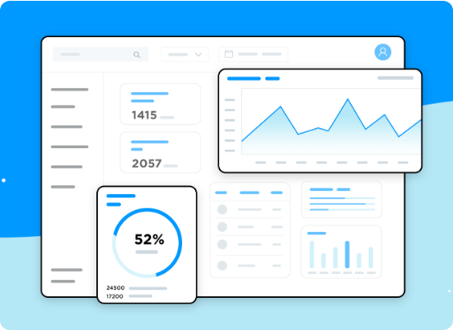
BACKGROUND & SURFACES
For internal reporting and dashboard interfaces, maintain high contrast and "breathing room."
Canvas: Always use #FFFFFF or #F8FAFC. No dark mode by default for heavy data tasks.
Visual Cards: Use white fill with a subtle 1px border (#E2E8F0) and soft shadow.
Separators: Use hair-line dividers in #CBD5E1 for sectioning.

Slide 5






CHART COLOR USAGE LOGIC
Single Series
Multi-Series
Status Color
Default to Ajio Navy (#243545). Use Gold only for specific "highlight" points.
Follow Navy > Blue Bayou > Vapor Gray > Gold sequence to maintain visual hierarchy.
Success: #10B981 Warning: #F59E0B Alert: #EF4444

Slide 6
BAR & COLUMN STANDARDS
Women's Ethnic
Western Wear
Footwear
Accessories
Design Rule: Use bars for rankings. Sort descending. Minimum gap of 20% between bars. Axis labels should be 10pt Regular DM Sans.

Slide 7
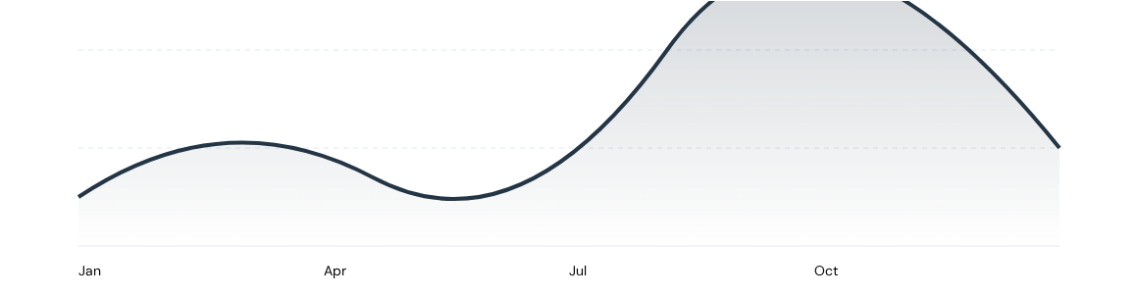
LINE & AREA TRENDS
Guideline: Lines should be 2.5pt weight. Use markers only for data points where specific precision is needed on hover. Area fill opacity strictly at 20%.

Slide 8



KPI CARDS & PROPORTIONS
GROSS MERCHANDISE VALUE
₹2,450 Cr
18.2% vs LW
72%
Mobile App
ACTIVE USERS (30D)
1.24 M
Donut Rule: Max 4 slices + "Others". Label values clearly.
Flat vs Prior Month

Slide 9
TABLE & DATA GRIDS
Product Category | Units Sold | Avg. Discount | Revenue | YoY Growth
Men's Sneakers | 14,200 | 40% | ₹4.2 Cr | +14%
Women's Kurtas | 32,500 | 50% | ₹8.1 Cr | +22%
Kids' Footwear | 8,400 | 20% | ₹1.8 Cr | -4%
Watches | 2,100 | 15% | ₹5.4 Cr | +31%
Grid Rule: Left-align text, right-align currency/numbers. Header background: #243545. No vertical gridlines allowed.

Slide 10
TYPOGRAPHY & FONT RULES
Page Titles: 44pt Urbanist Bold (#243545)
AA
Section Headers: 24pt Urbanist SemiBold
Data Labels: 11pt DM Sans Regular (#4B5563)
Urbanist Bold
KPI Metrics: 48pt Urbanist Bold
Table Content: 10pt DM Sans Regular

Slide 11

LAYOUT & GRID
Maintain a 1920x1080 canvas for dashboards with 40px outer margins.
Header: Fixed 80px height in Navy.
Sidebar: Collapsible 240px width.
Visual Gap: 24px consistent spacing between all visual cards.
Filter Panel: Right-side drawer for drill-down controls.

Slide 12


DO'S & DON'TS CHECKLIST
DO
DON'T
Use Navy for all primary chart series.
Don't use gradients or 3D effects on charts.
Ensure 4.5:1 contrast ratio for all text.
Avoid "Pie Charts" with more than 5 slices.
Use Gold sparingly as a visual call-to-action.
Never use generic Red for branding (it signifies Alert).
Keep chart titles concise and bold.
Don't overcrowd pages; limit to 6 visuals max.
Maintain alignment across all dashboard cards.
Avoid hard black backgrounds for reports.

